Slide 1
WITH LOVE
TO
BHAGAVAN

Slide 2
LOVE FOR GOD
FEAR OF SIN
MORALITY IN SOCIETY

Slide 3
INDIA IS NOT ON AUTOPILOT MODE TO GREATNESS. BUT IT WOULD TAKE AN INCOMPETENT PILOT TO CRASH THE PLANE – HOW WOULD YOU LIKE TO PILOT INDIAN ORGANISATIONS TO GET BACK ITS PRISTINE GLORY?

Slide 4
FAQs
WHAT IS LOVE?
WHAT IS GOD?
WHAT IS LOVE FOR GOD?
WHAT IS SIN?
WHY SHOULD PEOPLE HAVE FEAR FOR SIN?
WHAT IS MORALITY?
WHAT IS MORALITY IN SOCIETY?
WHAT WOULD HAPPEN IF SOCIETY LACKS MORALITY?
DO LOVE FOR GOD & FEAR OF SIN HAVE ANY INFLUENCE ON MORALITY IN SOCIETY?

Slide 5
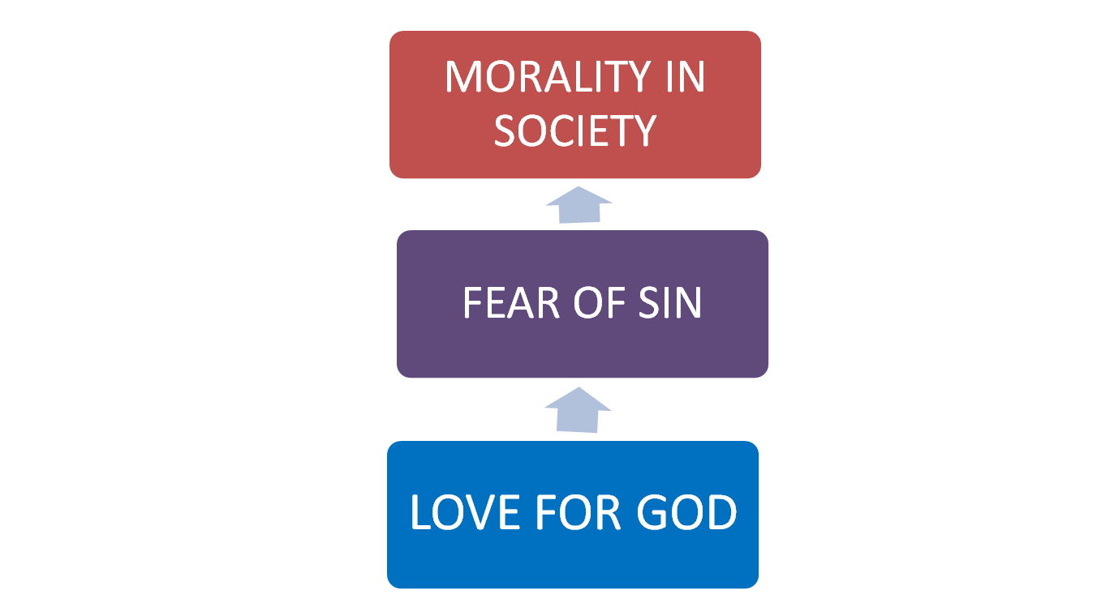
IS IT LINEAR?

Slide 6
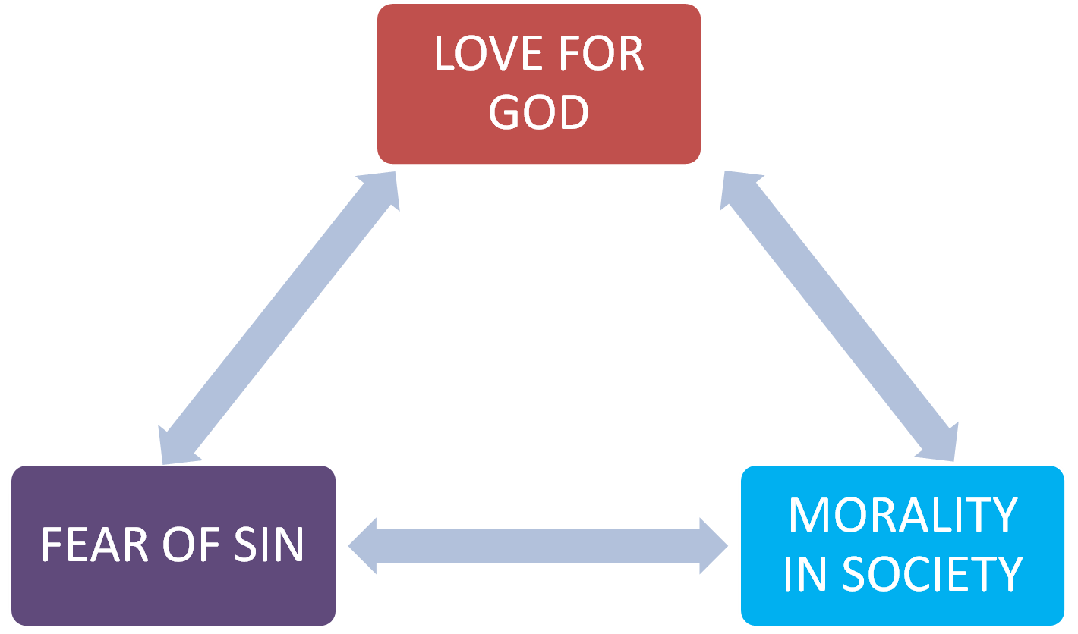
IS IT NON-LINEAR?

Slide 7
KEY TERMS
LOVE
GOD
FEAR
SIN
MORALITY
SOCIETY

Slide 8
KEY TERMS - MEANING
LOVE: A STRONG FEELING OF AFFECTION: A FEELING OF FONDNESS OR LIKING.
GOD: THE CREATOR AND SUPREME RULER OF THE UNIVERSE; SUPER HUMAN BEING OR SPIRIT; A GREATLY ADMIRED OR INFLUENTIAL PERFECT PERSON.
FEAR: AN UNPLEASANT EMOTION CAUSED BY A THREAT OF DANGER, PAIN, OR HARM; THE LIKELIHOOD OF SOMETHING UNNWELCOME HAPPENING.
SIN: IF A WRONG ACT IS COMMITTED INNOCENTLY - IT IS A MISTAKE/ERROR; BUT IF THE SAME MISTAKE IS REPEATED KNOWING FULLY WELL THAT IT IS WRONG IS A SIN.
MORALITY: PRINCIPLES CONCERNING THE DIFFERENCE BETWEEN RIGHT AND WRONG.
SOCIETY: A COMMUNITY OF PEOPLE LIVING IN A COUNTRY OR REGION, AND HAVING SHARED CUSTOMS, LAWS, AND SOCIAL INSTITUTIONS.

Slide 9
LOVE FOR GOD
STRONG FEELING OF AFFECTION, FONDNESS OR LIKING FOR:
PUPOSEFUL AND MEANINGFUL WORK;
PROFESSIONAL EXCELLENCE;
EMPLOYING ORGANISATION – EMPLOYER;
BOSS, SUPERIOR, MASTER,GURU, ETC.;
A PERFECT AND INSPIRING LEADER;
PEOPLE, PLANET, AND [PROFIT];
COMMUNITY
SOCIETY

Slide 10
FEAR OF SIN
AN UNPLEASANT EMOTION EXPECTED TO OCCUR IN CASE OF ANY DEEDS UNDERTAKEN – FULLY AWARE OF THE IMPLICATIONS AND UNFAVOURABLE CONSQUENCES IN RELATION TO:
ALL STAKEHOLDERS – BOTTOM OF THE PYRAMID, CUSTOMERS, CONSUMERS, COMPETITORS, EMPLOYEES, COMMUNITY, INVESTORS, FUTURE GENERATIONS, SOCIETY AND ENVIRONMENT

Slide 11
MORALITY IN SOCIETY
PRINCIPLES GOVERNING RIGHT/WRONG AMONG A COMMUNITY OF PEOPLE IN A COUNTRY OR REGION - BY WAY OF SHARED VALUES CUSTOMS, LAWS, AND SOCIAL INSTITUTIONS:
SOCIAL EQUILIBRIUM
DYNAMIC BALANCE
SOCIAL ORDER – LAW AND ORDER
SOCIAL HARMONY
SOCIAL COHESIVENESS

Slide 12
(Y)OUR ROLE AS PILOTS!
SPIRIT@WORK.
PROFESSIONAL EXCELLENCE.
BE THE CULTURE BEFORE PREACHING CULTURE
SAMATWAM – BOQUETS & BRICKBATS, SUCCESS & FAILURE, IMPORTANT & UNIMPORTANT, HIGH & LOW, SIGNIFICANT & INSIGNIFICANT, INFERIOR & SUPERIOR, ORDINARY & EXTRAORDINARY, ETC.
BE A LIVE ELECTRIC WIRE.
HARD WORKING NOT HARDLY WORKING
FUNCTIONAL MANAGER NOT FUNCTIONS MANAGER

Slide 13
INDIA IS NOT ON AUTOPILOT MODE TO GREATNESS. BUT IT WOULD TAKE AN INCOMPETENT PILOT TO CRASH THE PLANE – HOW WOULD YOU LIKE TO PILOT INDIAN ORGANISATIONS TO GET BACK ITS PRISTINE GLORY? INDIA IS NOT ON AUTOPILOT MODE TO GREATNESS. BUT IT WOULD TAKE AN INCOMPETENT PILOT TO CRASH THE PLANE – HOW WOULD YOU LIKE TO PILOT INDIAN ORGANISATIONS TO GET BACK ITS PRISTINE GLORY?

Slide 14
AN ARMY OF SHEEP
LEAD BY A LION
CAN EASILY DEFEAT
AN ARMY OF LIONS
LEAD BY A SHEEP
[ARABIAN SAYING]

Slide 15
WHAT WE EXPECT IN UR PRESENTATION?
HOW DO YOU INTEND TO (PILOT) OPERATIO-NALISE/ INSTITUTIONALIZE [WAYS AND MEANS] AS INSTRUMENTS OF SBMAF/SSSU:
- LOVE FOR GOD
- FEAR OF SIN
- MORALITY IN SOCIETY
IN YOUR FUTURE EXECUTIVE LIFE BEARING IN MIND THE CONSTRAINTS AND CHALLENGES PREVAILING IN SOCIETY TODAY .

Slide 16
SAI RAM
&
THANK YOU

